Slide 1


Flood monitoring & early warning
DEPARTMENT OF COMPUTER SCIENCE AND ENGINEERING
TEAM NAME: TEAM MEMBERS: 1.RAM KUMAR.N(113321104079)
Proj_224785_Team_2 2.RANJITH.Y(113321104080)
3.SANTHOSH.K(113321104085)
4.SANTHOSH.N(113321104086)

Slide 2
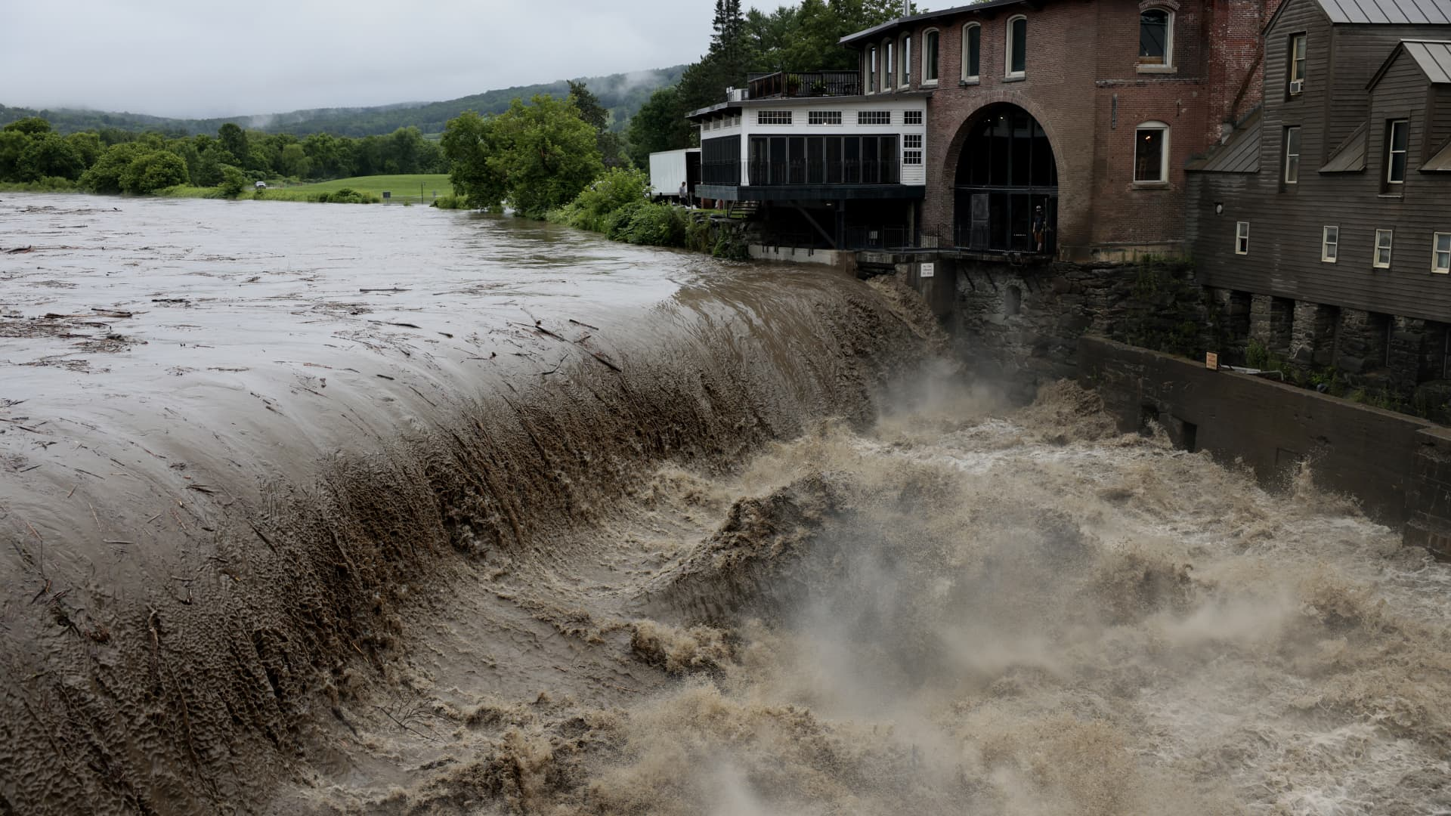
PROBLEM DEFINITION
a. Detect and monitor flood-related parameters such as water level, rainfall intensity, and weather conditions in real-time.
The problem at hand is to design, implement, and deploy an efficient and reliable IoT-based flood monitoring and early warning system to:
b. Analyze and process the collected data to assess flood risk and predict potential flood events.
c. Disseminate timely and accurate warnings to relevant authorities, emergency responders, and affected communities to facilitate preparedness and evacuation measures.
d. Establish a robust communication infrastructure that can operate in adverse conditions and ensure the delivery of warnings to remote and vulnerable areas.
e. Provide a user-friendly interface for end-users to access and interpret flood-related information and warnings.
Detect and monitor flood-related parameters such as water level, rainfall intensity, and weather conditions in real-time.
The problem at hand is to design, implement, and deploy an efficient and reliable IoT-based flood monitoring and early warning system to:
a. Analyze and process the collected data to assess flood risk and predict potential flood events.
b. Disseminate timely and accurate warnings to relevant authorities, emergency responders, and affected communities to facilitate preparedness and evacuation measures.
c. Establish a robust communication infrastructure that can operate in adverse conditions and ensure the delivery of warnings to remote and vulnerable areas.
d. Provide a user-friendly interface for end-users to access and interpret flood-related information and warnings.

Slide 3
objectives
1.Data Transmission and Connectivity: Establish a robust communication infrastructure to ensure seamless data transmission from sensors to a central server or cloud platform, even in adverse weather conditions.2
2.Real-Time Data Collection: Implement IoT sensor networks to collect real-time data on critical parameters such as water level, rainfall, weather conditions, and river/stream flow rates.
3.Data Processing and Analysis: Develop data analytics and machine learning algorithms to process and analyze the collected data for early flood detection, risk assessment, and prediction.
4.Threshold-Based Alerting: Set up threshold values for each parameter and create an automated alert system that triggers warnings when these thresholds are exceeded, signaling the potential for flooding.
5.Multi-Channel Warning Dissemination: Design a warning system that can disseminate alerts and warnings via multiple communication channels, including SMS, mobile apps, sirens, email, and social media.
6.Geospatial Mapping and Visualization: Create user-friendly geospatial maps and visualization tools to display real-time flood-related information, including flood extents, affected areas, and evacuation routes.
7.Public Awareness and Education: Develop educational materials and campaigns to raise public awareness about flood risks, the use of the early warning system, and appropriate response procedures.
8.Integration with Emergency Services: Integrate the flood monitoring system with local emergency services and authorities to ensure coordinated response efforts during flood events.

Slide 4
9.Remote Monitoring and Control: Enable remote monitoring and control of the IoT system, allowing administrators to adjust sensor parameters, update warning thresholds, and perform system maintenance remotely.
10.Historical Data Logging: Maintain a historical database of flood-related data for post-event analysis, trend identification, and continuous improvement of the warning system.
11.Scalability and Expansion: Design the system with scalability in mind to accommodate future sensor deployments and expand coverage to additional flood-prone areas.
12.Cost-Effective Maintenance: Develop a cost-effective maintenance plan to ensure the longevity of sensors and communication infrastructure while minimizing operational costs.
13.Regular Testing and Drills: Conduct regular system testing, drills, and simulations to ensure that all stakeholders are familiar with the warning system and response procedures.
14.Compliance with Regulations: Ensure that the system complies with relevant regulations, standards, and data privacy laws governing IoT and disaster management.
15.Continuous Improvement: Establish a process for continuous improvement by regularly reviewing system performance, analyzing user feedback, and incorporating technological advancements.
Meeting these objectives will help create an effective flood monitoring and early warning system using IoT technology, which can significantly reduce the impact of flood disasters on communities and infrastructure.

Slide 5
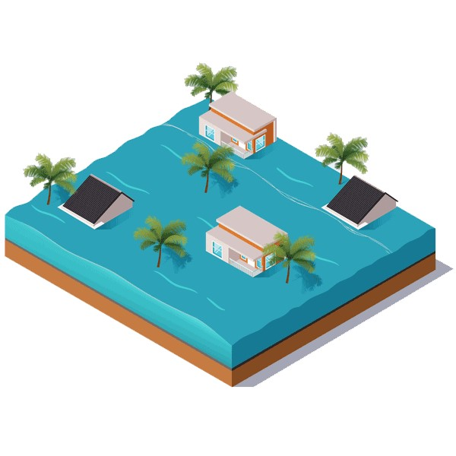
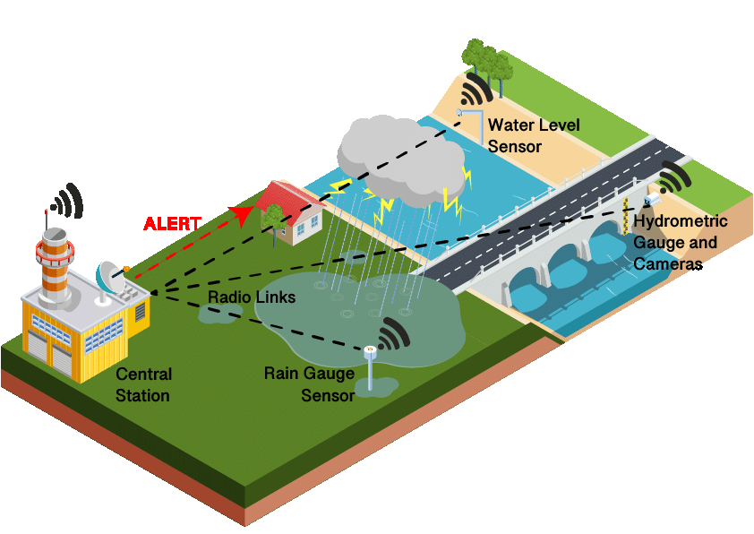
iot sensor design
1.Identifying key parameters:
1.Water level
2.Rainfall intensity
3.Weather e.g., temperature, humidity, wind speed)
4.River/stream flow rates
2.Sensor Selection:
1.Water level sensors can use ultrasonic, pressure, or radar technology.
2.Rain gauges for measuring rainfall intensity can be tipping bucket or optical sensors.
3.Weather conditions can be monitored using a combination of sensors (e.g., temperature and humidity sensors, anemometers).
4.River/stream flow rates may require specialized flow sensors.
3.Power Supply:
1. Solar panels for remote locations
2.Battery backups for continuous operation during power outages
3.Low-power consumption to extend battery life
4.Environmental Protection:
1.Sensors are housed in weatherproof and rugged enclosures to protect them from adverse environmental conditions.
2.It includes heavy rainfall.

Slide 6
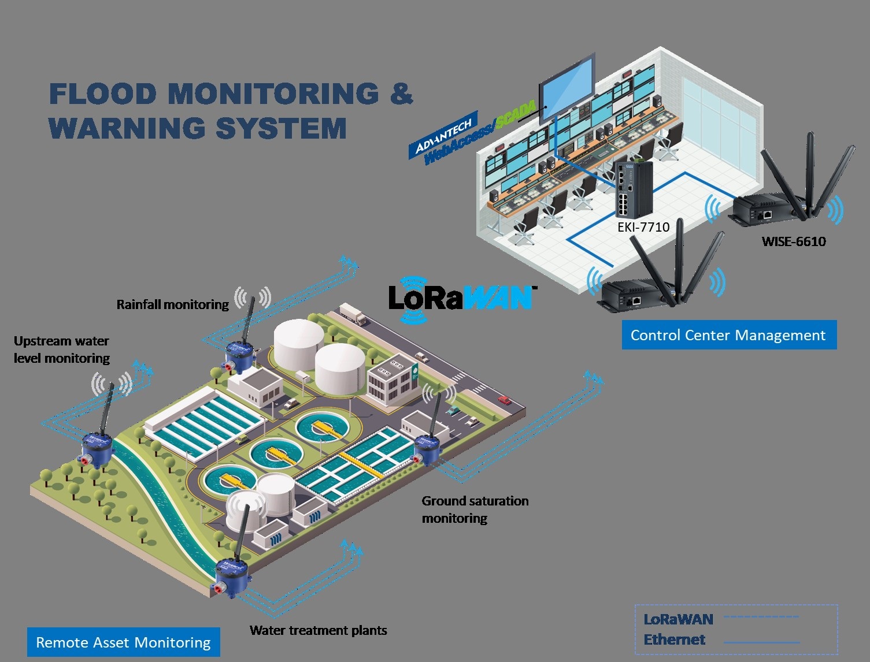
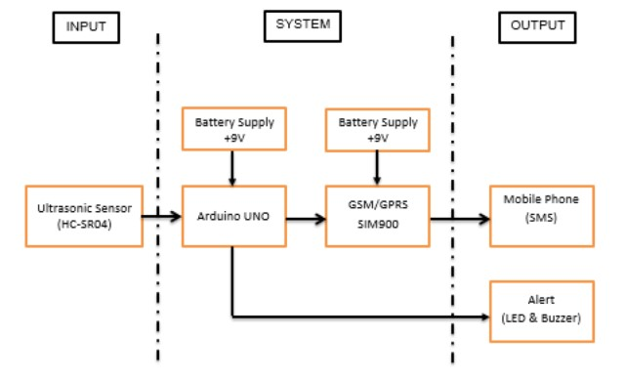
5.Remote Monitoring and Control:
1.Sensor settings.
2.perform maintenance.
3.troubleshoot issues remotely.
6.Security Measures:
1.Implement security measures to protect sensor data.
2.Prevent tampering.
3.Use encryption for data transmission and authentication mechanisms for data access.
7.Real-Time Clock (RTC): Include an RTC module to timestamp data accurately
1.Enabling synchronization with other sensors.
2.Systems.

Slide 7
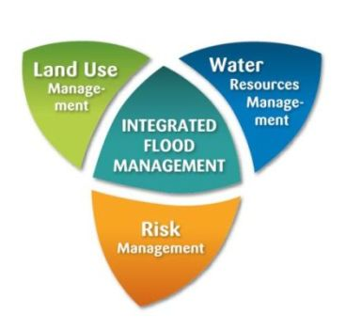
Integration approaches
An integrated approach for flood monitoring and early warning combines various technologies, data sources, and stakeholders to create a comprehensive system for mitigating flood risks and providing timely alerts. Here's a integrated flood monitorin and early warning:
1.Multi-Sensor Data Collection:
*The main tools used to detect heavy rainfall associated with flash floods are satellite, lightning observing systems, radar, and rain gauges. What we do: NSSL's research team includes hydrologists, hydrometeorologists and civil engineers to approach flash flood detection and forecasting from all angles.
*Deploy a network of IoT sensors (e.g., water level, rainfall, weather, river flow) in flood-prone areas.
*Integrate data from existing sources such as weather stations, river gauges, and remote sensing satellites

Slide 8
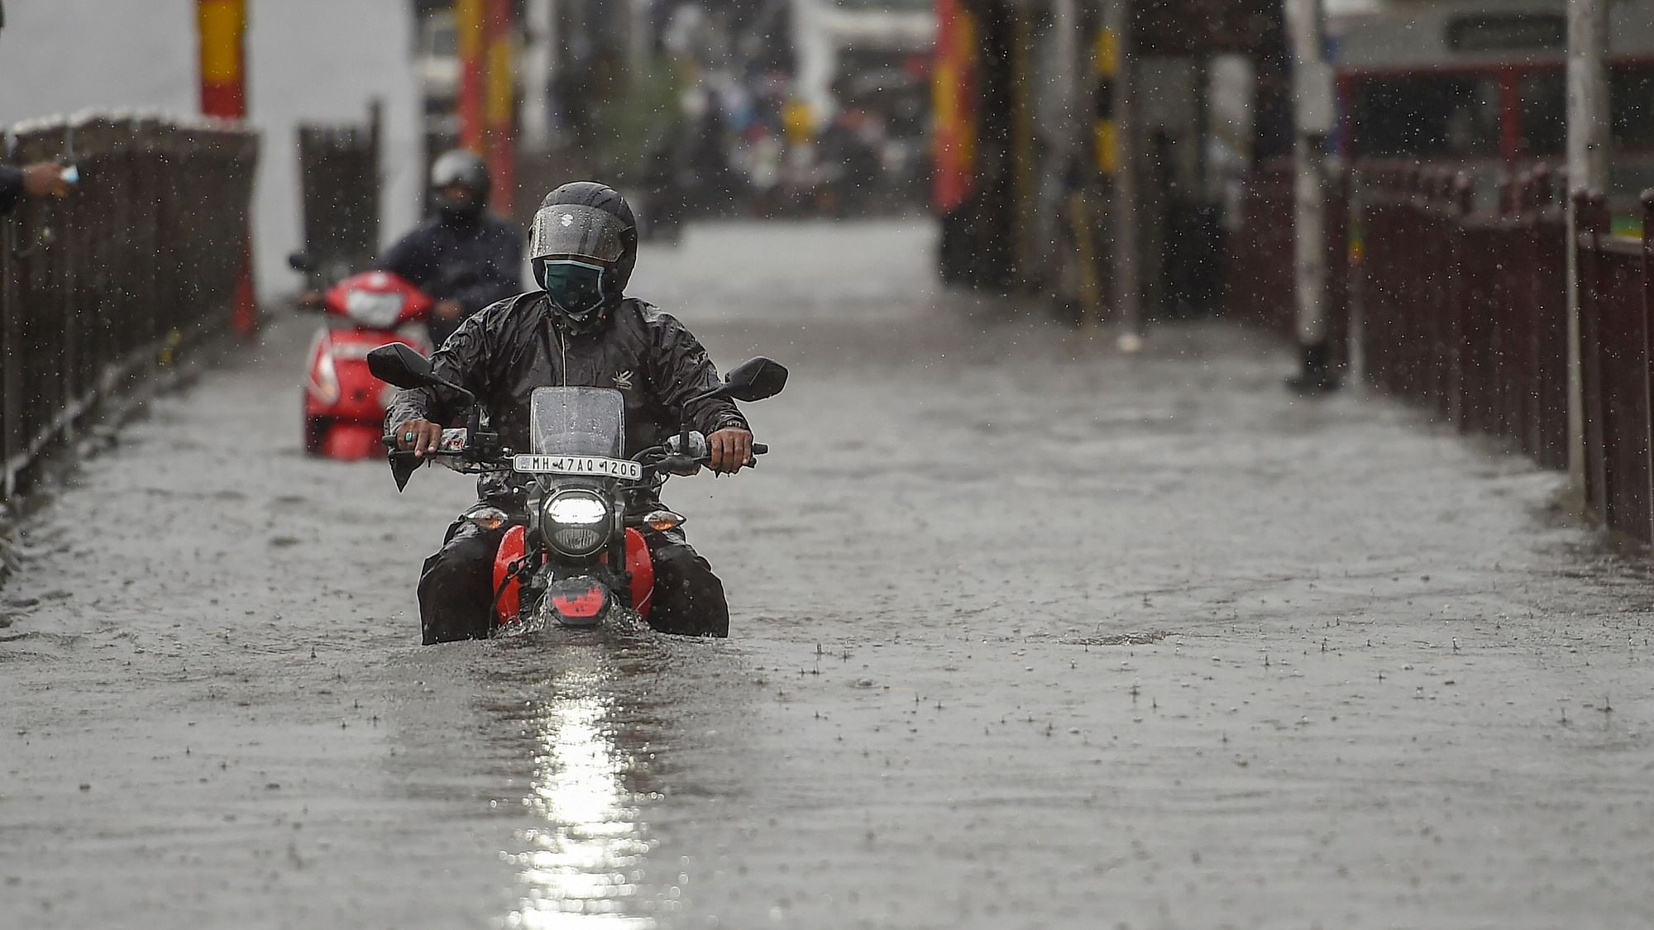
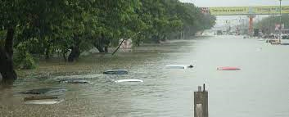
2.Real-Time Data Analytics:
*Utilize real-time data analytics and machine learning algorithms to process and analyze the data.
*Detect anomalies, trends, and potential flood events based on historical and current data patterns.
*With data about the volume and timing of flows in hand, we use geographic information system (GIS) data to estimate the regions that will be inundated by flooding, based on precise contour models of the terrain.

Slide 9
Integration benifits
Integration allows for the collection and analysis of data from multiple sources, including IoT sensors, weather stations, river gauges, and remote sensing satellites. This comprehensive data analysis provides a more accurate and holistic understanding of current environmental conditions and flood risk.
High reliability as data is sent in real-time.
Timely detection of flood risks.
Tailored solutions that can easily be integrated with external development at any level such as connectivity, user application, and device.
The main tools used to detect heavy rainfall associated with flash floods are satellite, lightning observing systems, radar, and rain gauges.

Slide 10


